Slide 1


Google Machine Learning courses
Notes:
https://developers.google.com/machine-learning/crash-course

Slide 2
What you will learn
Linear Regression
Logistic Regression
Classification
Working with Numerical Data
Working with Categorical Data
Datasets, Generalization, and Overfitting
Neural Networks
Embeddings
Large Language Models
Production ML Systems
AutoML
ML Fairness

Slide 3
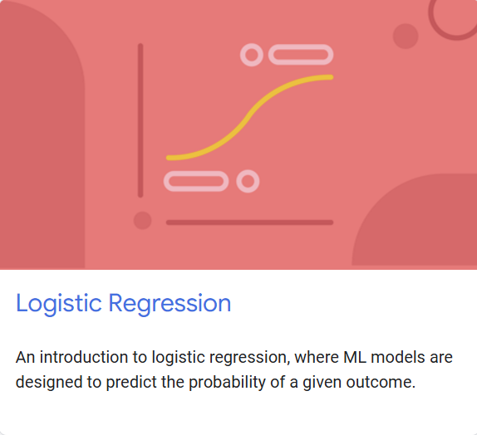
Logistic regression
Notes:
https://developers.google.com/machine-learning/crash-course/linear-regression

Slide 4
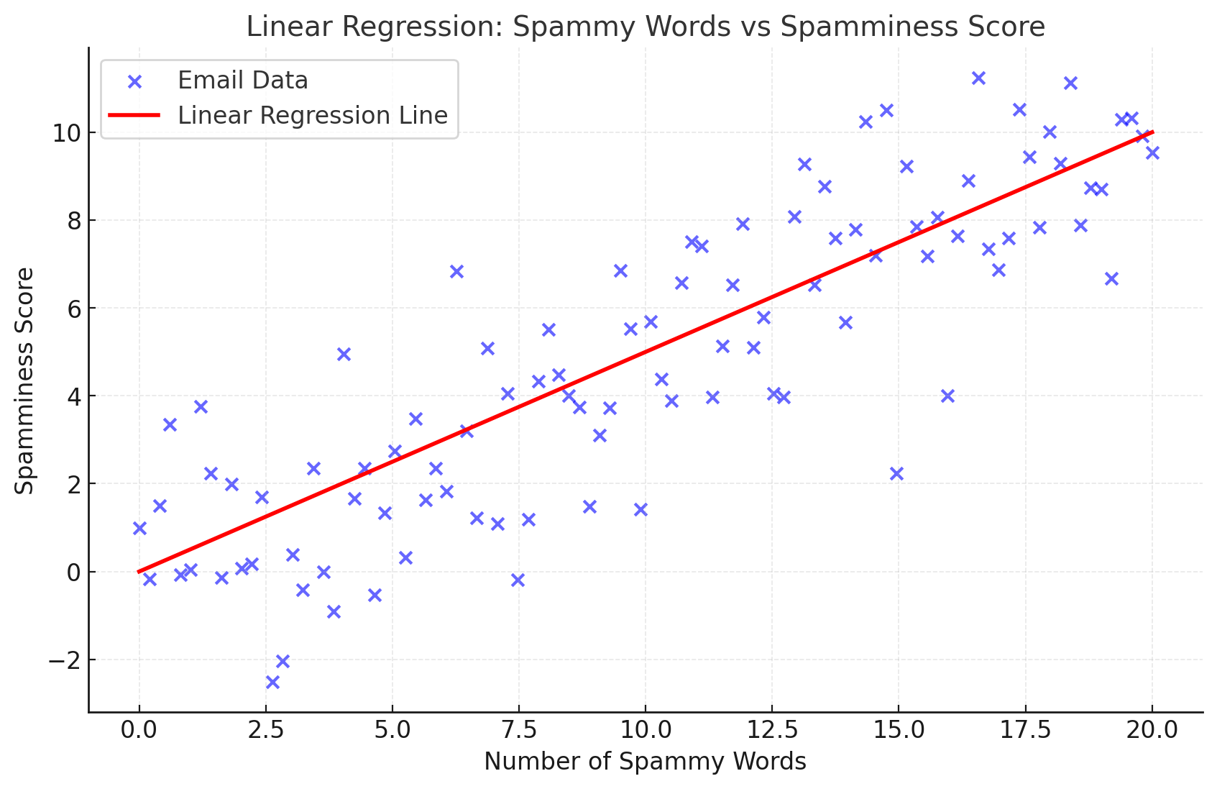

Slide 5
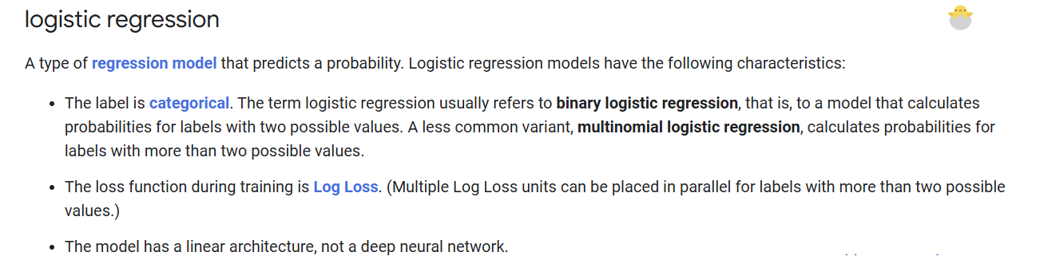

Slide 6
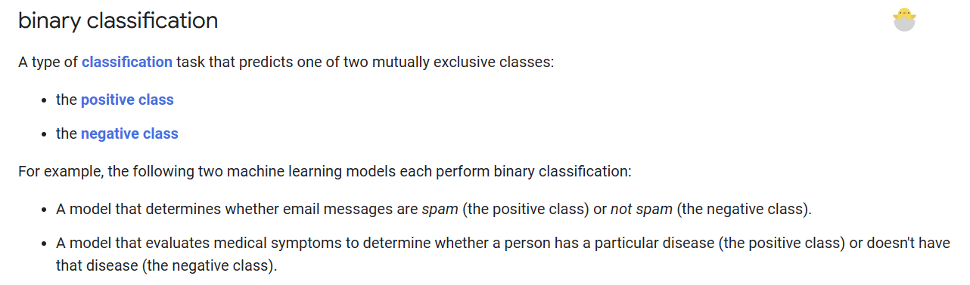

Slide 7


Slide 8
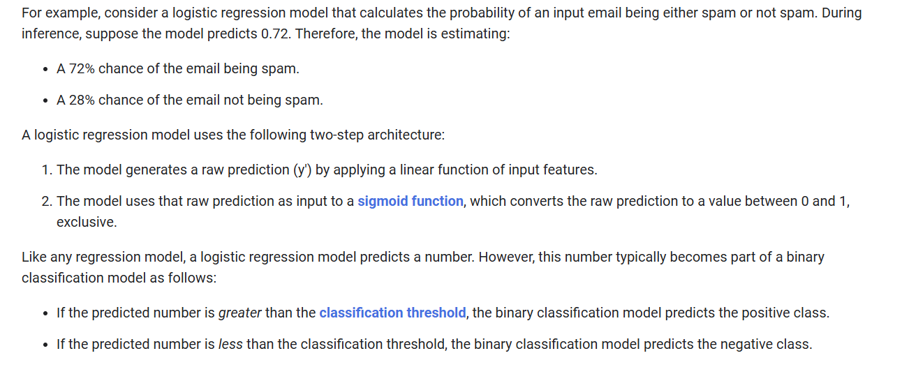

Slide 9
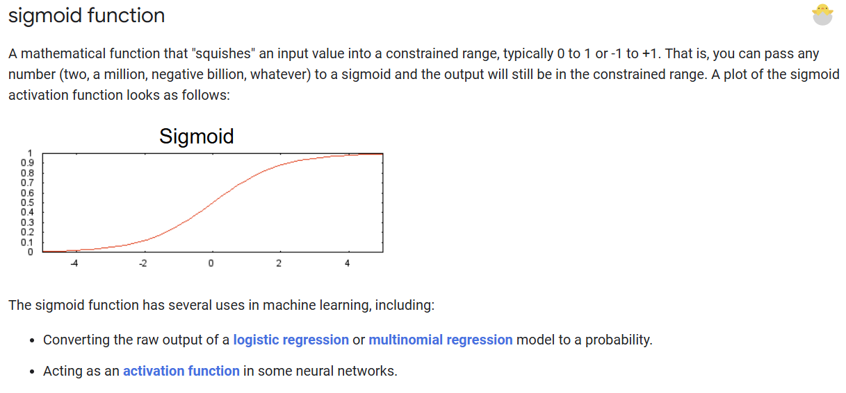

Slide 10
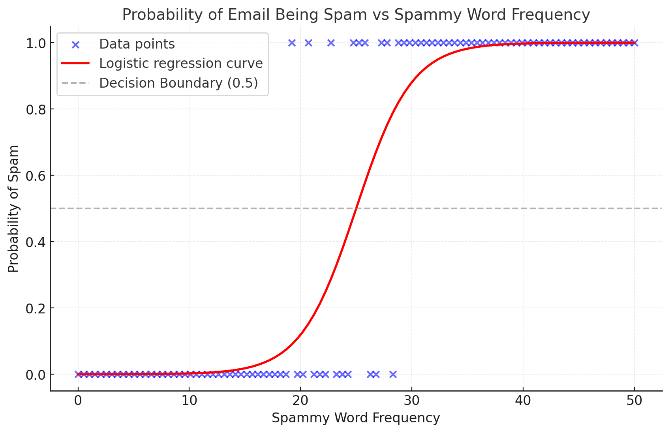

Slide 11
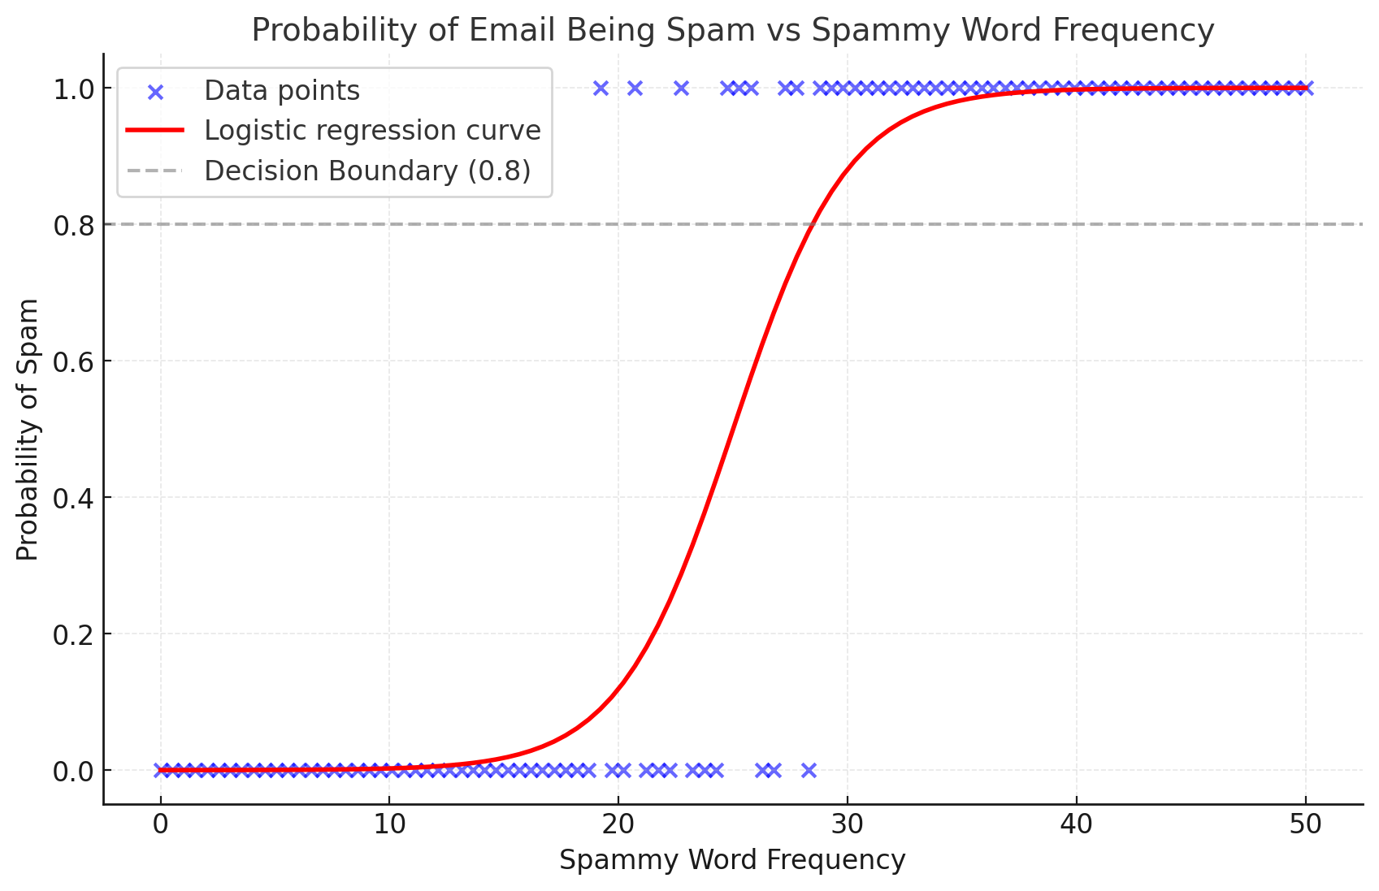

Slide 12


Slide 13
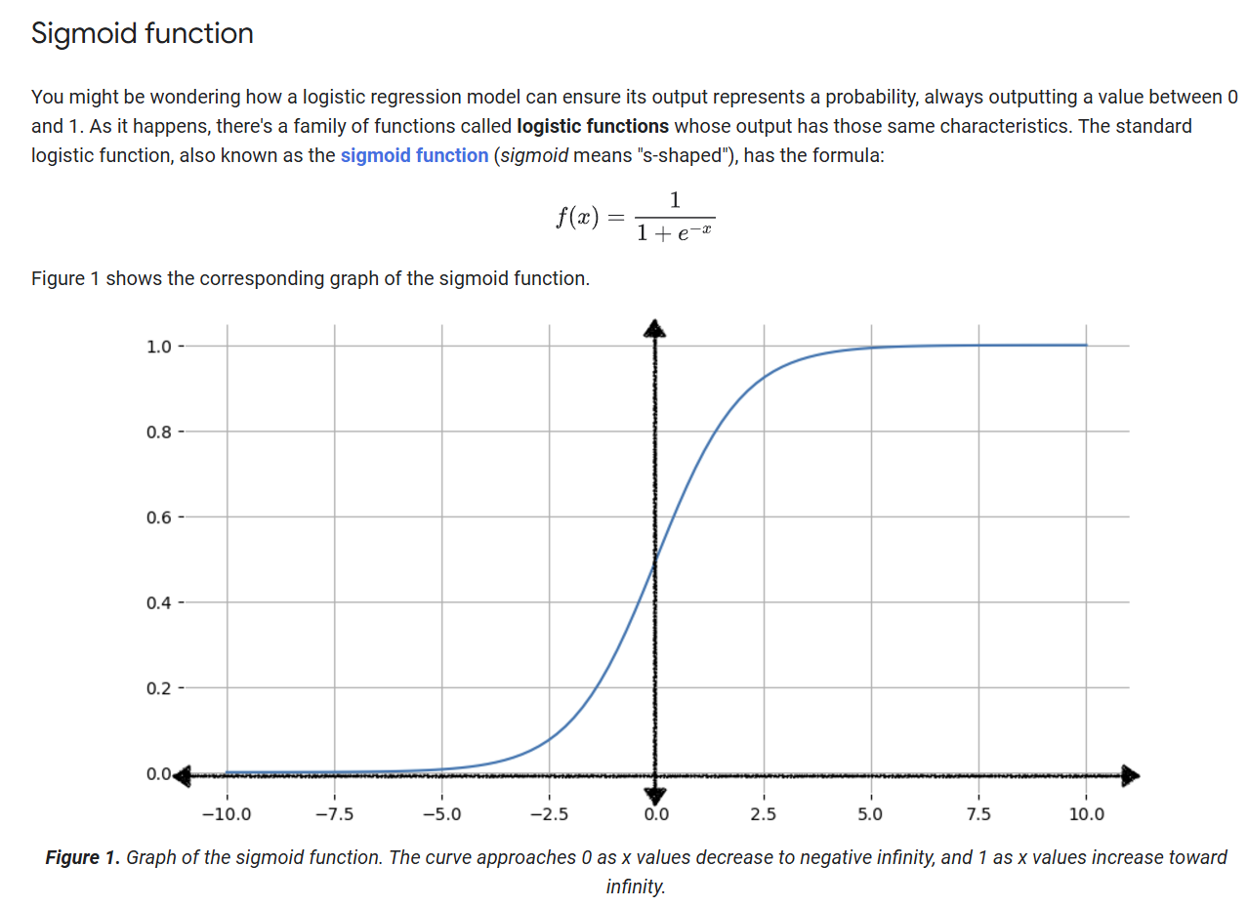

Slide 14
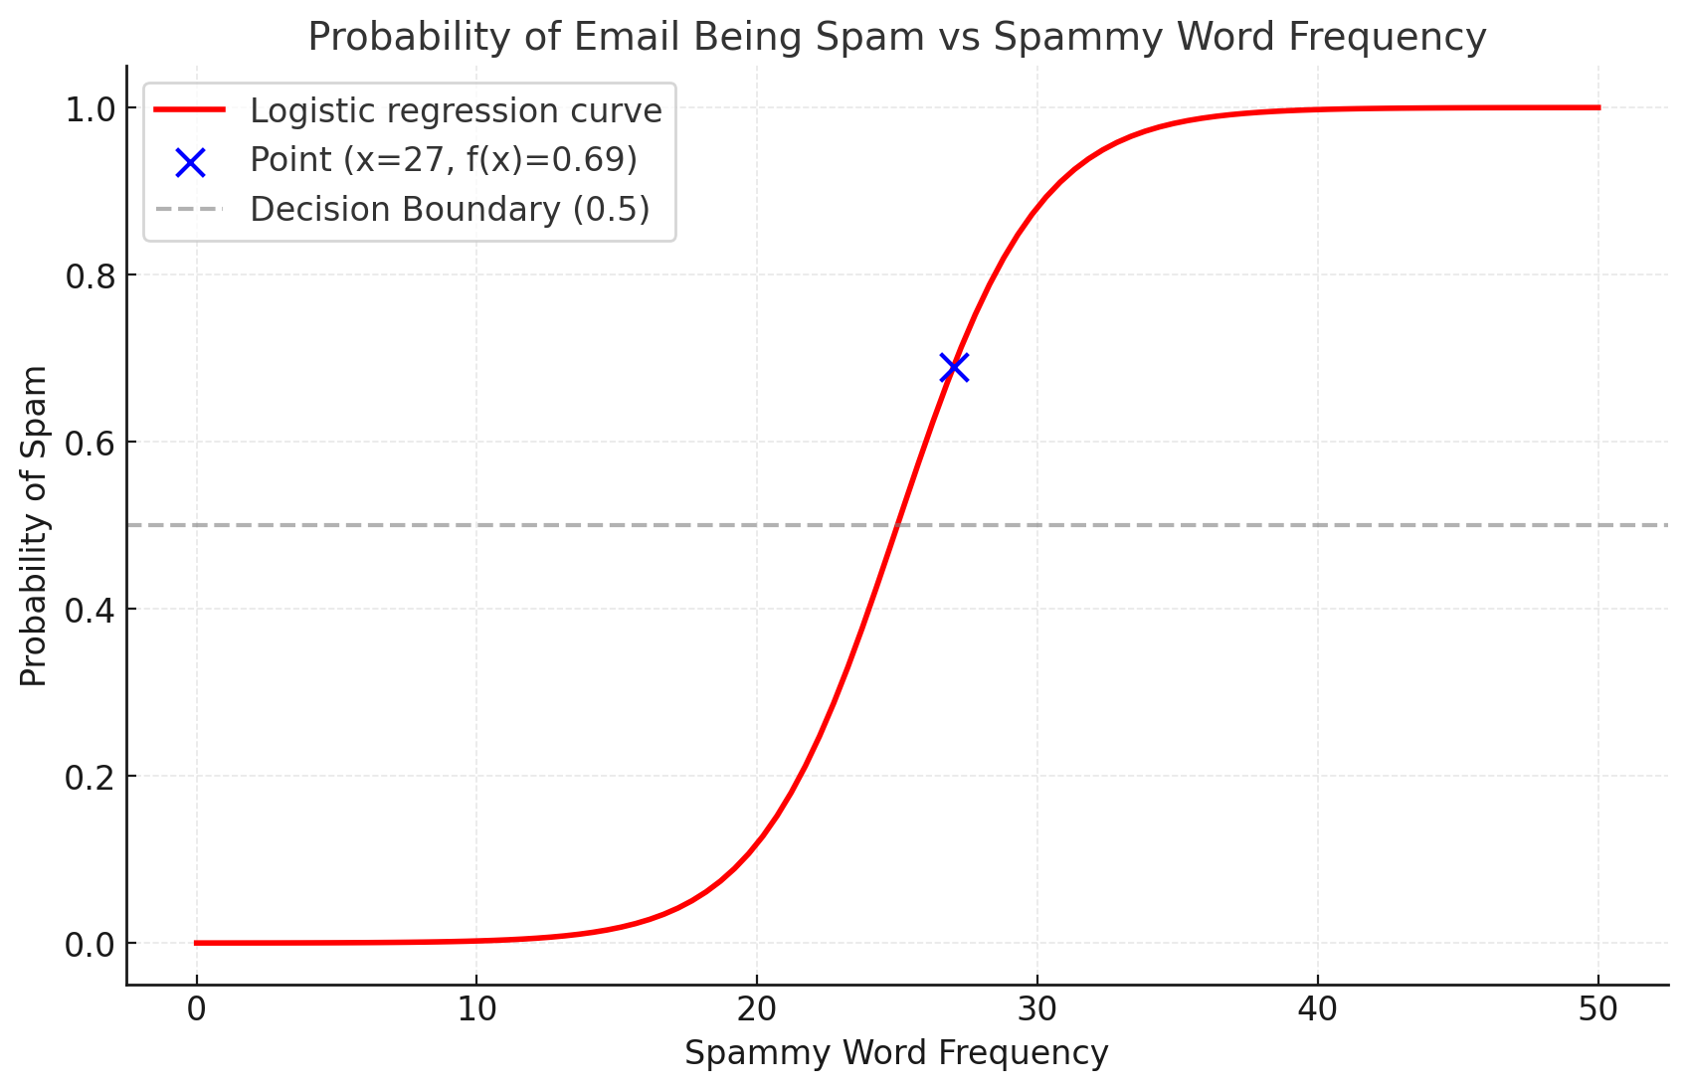

Slide 15
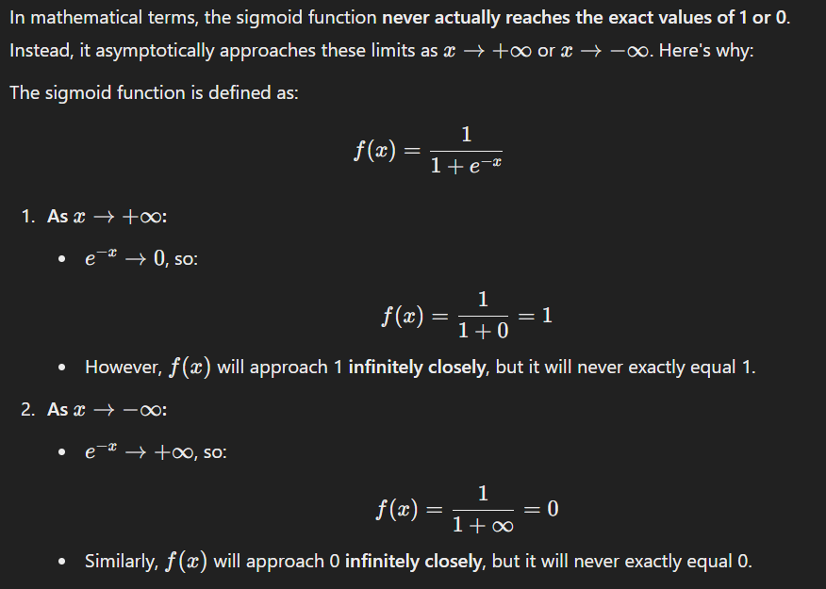

Slide 16
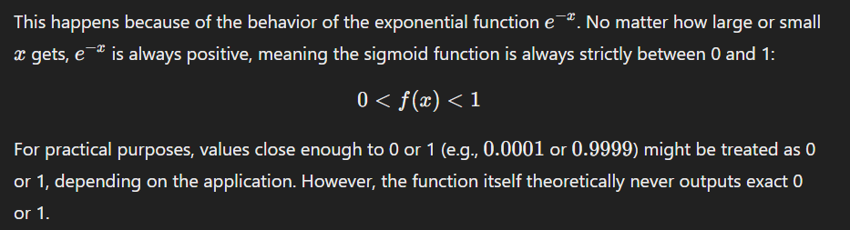

Slide 17
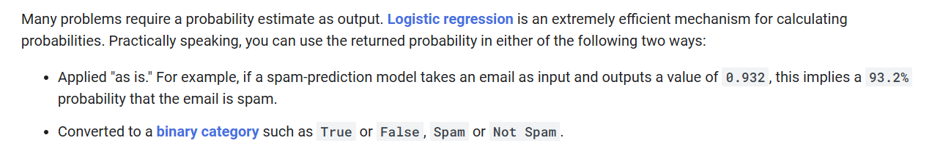

Slide 18




Notes:
https://www.youtube.com/channel/UC35ZpwldGw7ZJ5R-2sLijzw

Slide 19
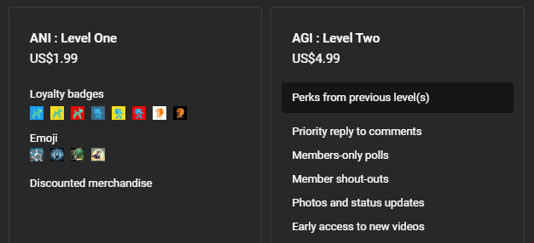
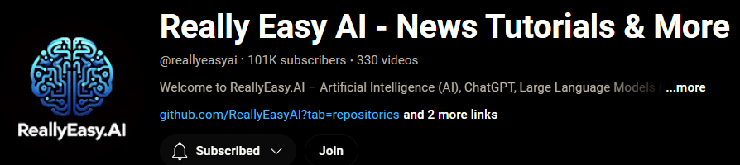
Membership has its privileges
Notes:
https://www.youtube.com/channel/UC35ZpwldGw7ZJ5R-2sLijzw/join

Slide 20

https://www.youtube.com/@AINewsFresh

Slide 21

https://www.youtube.com/@DailyAINewsPodcast

Slide 22

https://www.youtube.com/@AIPapersPodcastDaily

Slide 23


Slide 24
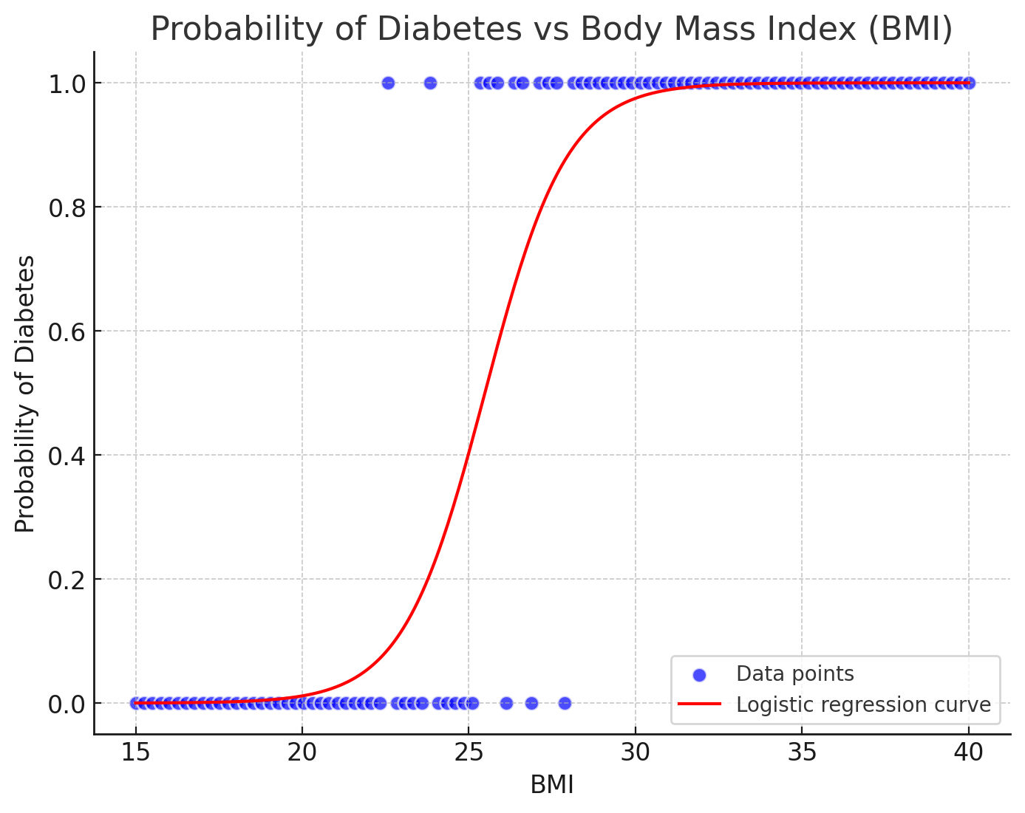

Slide 25
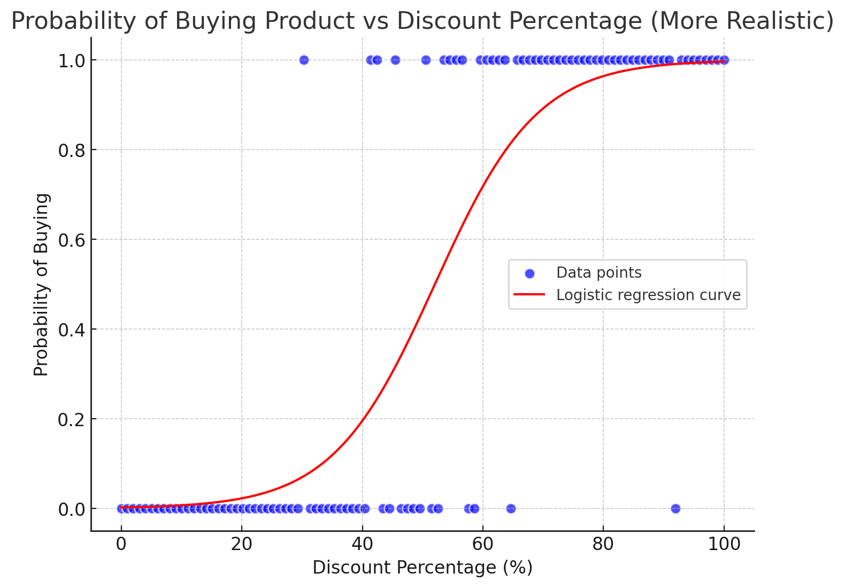

Slide 26
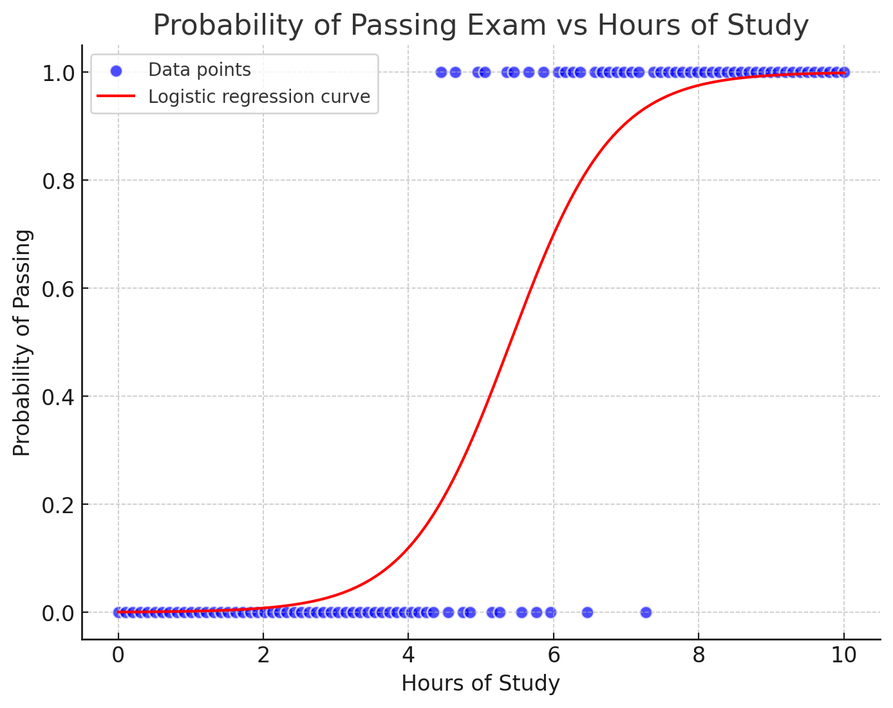

Slide 27


